Slide 1

Housing Management Application Client – BrightStay Hosuing
Submitted by
Group -8
Sai Nikhitha
Anbu Arasan
Sai Kumar Kurapati
Venugopal Rao Jupalli

Slide 2
Use Cases
Use Case Name: Student Registration ID: UC-1 Priority: High
Actor: Student
Description: Allows students to register and access the system.
Trigger: A new student wants to create an account.
Preconditions: The system is accessible online.
Normal Flow: Students navigate to the registration page. Fill in the registration form with name, email, and password. Submits the form. The system validates email and stores user data. The system confirms registration.
Postconditions: The student is registered and can log in.

Slide 3
Use Case Name: Student Login ID: UC-2 Priority: High
Actor: Student
Description: Allows students to log into the system.
Trigger: A registered student attempts to log in.
Preconditions: The student must be registered.
Normal Flow: Students navigate to the login page. Enters login credentials. System validates credentials. If valid, access is granted; otherwise, an error message is displayed.
Postconditions: The student gains access to their account.

Slide 4
Use Case Name: Room Allocation ID: UC-3 Priority: High
Actor: Student, Admin
Description: Assigns rooms to students automatically or manually
Trigger: A student completes registration.
Preconditions: The student is registered, and rooms are available.
Normal Flow: Admin accesses the room allocation module. The system suggests an available room based on predefined rules. Admin approves or modifies the room assignment. System updates room allocation records.
Postconditions: The student is assigned a room.

Slide 5
Use Case Name: Rent Payment ID: UC-4 Priority: High
Actor: Student
Description: Enables students to track and pay their rent.
Trigger: Student initiates a rent payment.
Preconditions: Students are logged in and rent is due.
Normal Flow: Student navigates to the payment section. System displays rent is due. Student selects payment methods and confirms payment. The system updates payment records.
Postconditions: Rent is marked as paid.

Slide 6
Use Case Name: Maintenance/Complaint Request ID: UC-5 Priority: High
Actor: Student, Admin
Description: Allows students to submit maintenance complaints and track resolution.
Trigger: Student experiences a maintenance issue.
Preconditions: Students are logged in.
Normal Flow: Student navigates to maintenance request section. Submits details of the issue. System logs request and notifies admin. Admin assigns maintenance staff. Staff resolves issue and updates status.
Postconditions: Maintenance requests are addressed.

Slide 7
Use Case Name: Leave/Exit Request Management ID: UC-6 Priority: Medium
Actor: Student, Admin
Description: Allows students to submit leave or exit requests.
Trigger: A student wants to leave the hostel temporarily or permanently.
Preconditions: Students are logged in.
Normal Flow: Student submits a leave request with dates and reason. Admin reviews the request. Admin approves or rejects the request.
Postconditions: Leave requests are approved or denied.

Slide 8
Use Case Name: Report Generation ID: UC-7 Priority: High
Actor: Admin
Description: Generates occupancy reports.
Trigger: Admin requests a report.
Preconditions: The system has sufficient data.
Normal Flow: Admin selects report type (occupancy, finance, maintenance). The system fetches relevant data. Report is generated and exported as PDF.
Postconditions: Reports are generated and stored for reference.

Slide 9
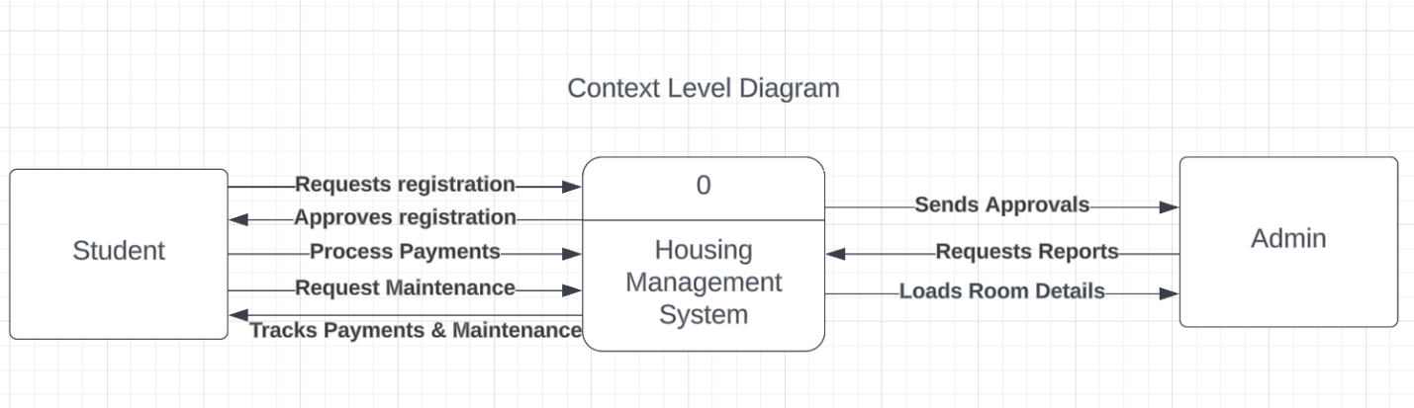
Context Level

Slide 10
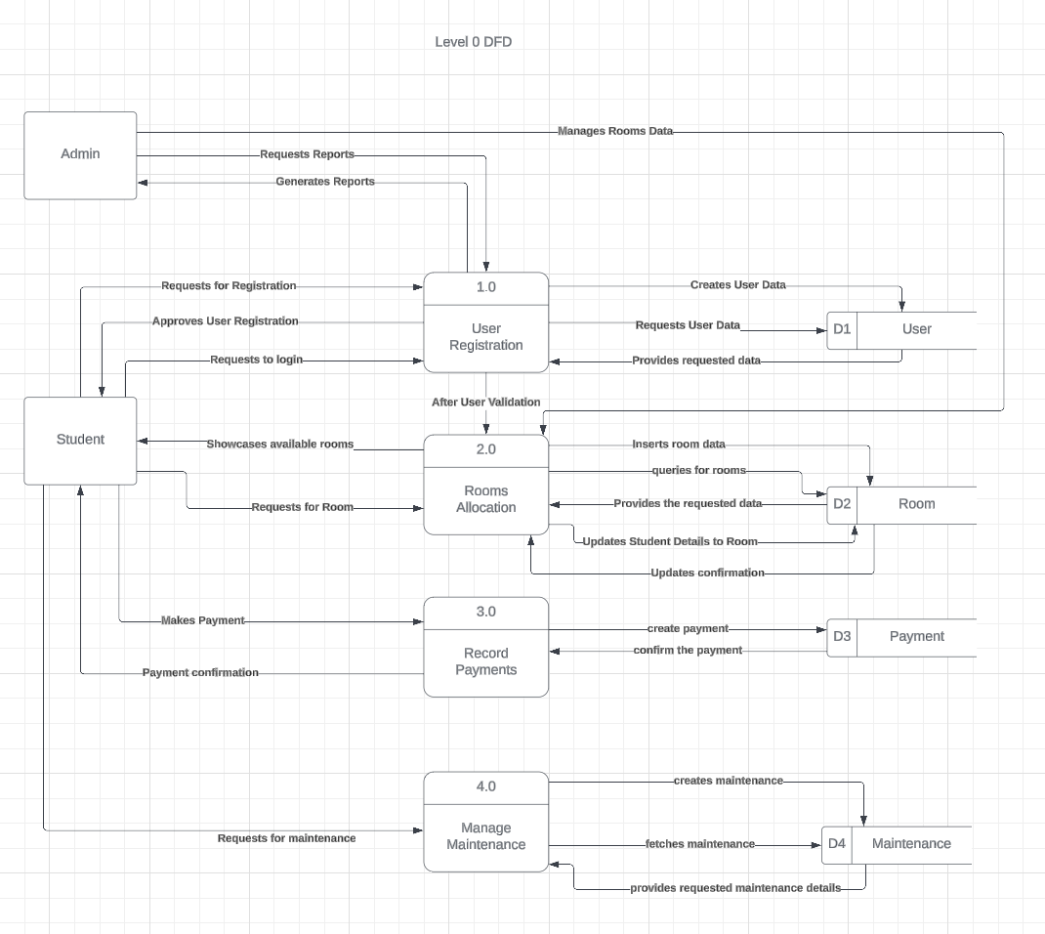
Level 0 DFD

Slide 11
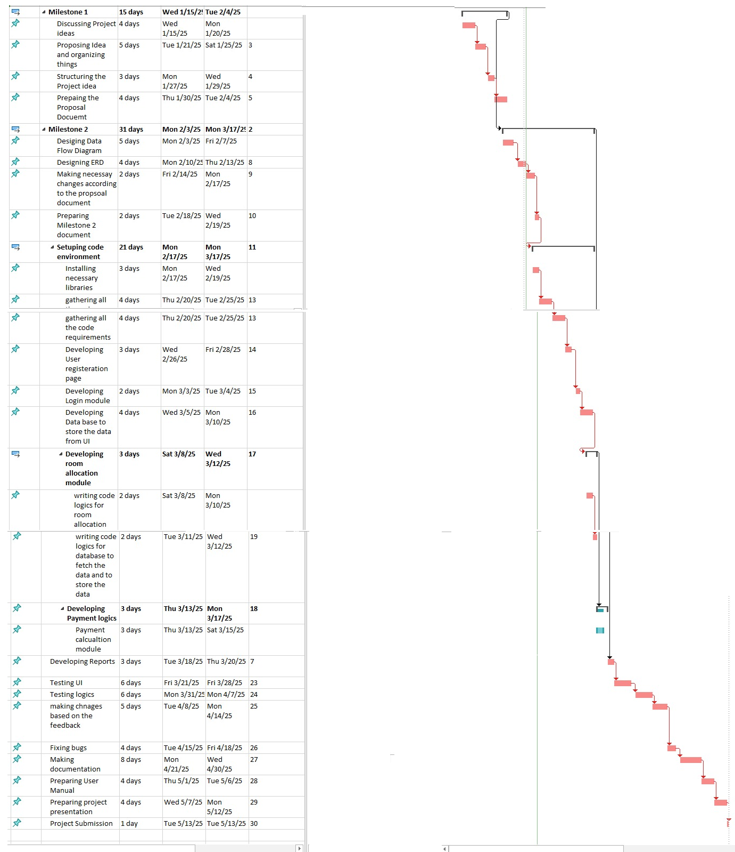
Task List

Slide 12
Critical Path

Slide 13
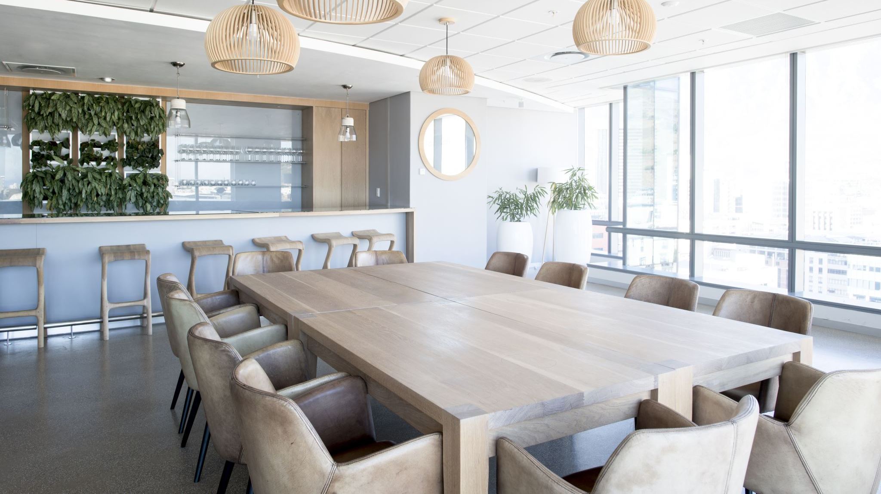
Thank you

